Slide 1
SEARCHING IN NONDETERMINISTIC ENVIRONMENTS
Notes:
https://www.youtube.com/watch?v=WIOVwvEMgSU

Slide 2
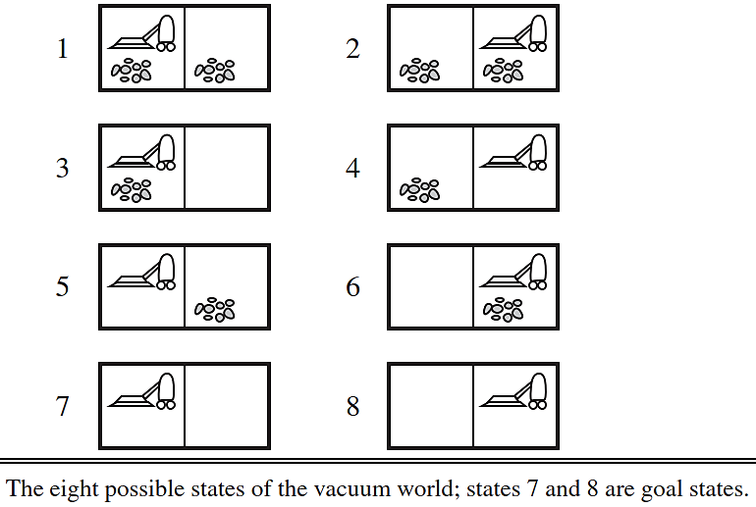













The vacuum world
Source: (Russell, 2016)

Slide 3





The erratic vacuum world
Suck action at a square:

Slide 4









We need 2 changes:
Transition model: RESULTS function
For example,
Solution:
For example,

Slide 5
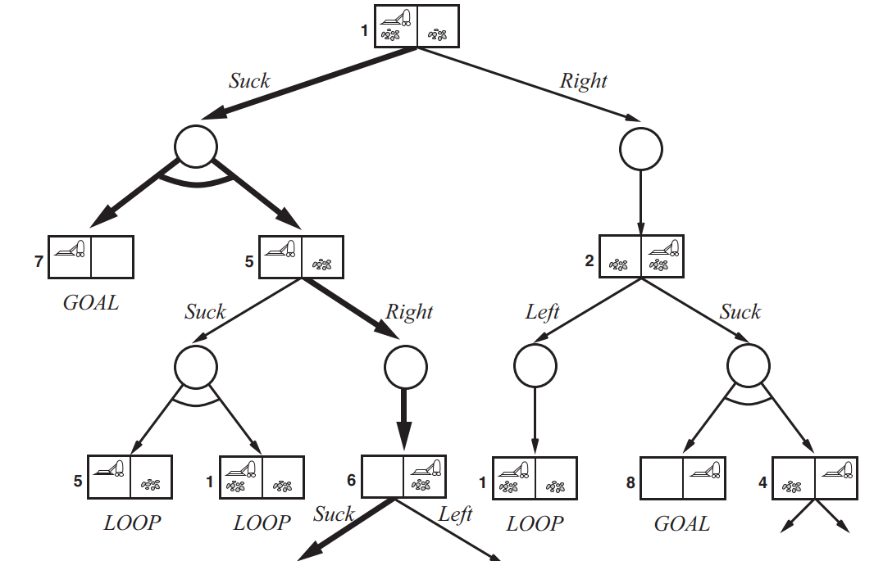





AND-OR search trees
AND-OR search trees
OR nodes:
AND nodes:
Image: (Russell, 2016)

Slide 6










































How solutions look like
In ordinary search tree:
A path
In AND-OR tree:
A subtree

Slide 7





A solution in AND-OR tree is
A subtree that:
1. All leaves nodes:
2. OR node:
3. AND node:

Slide 8
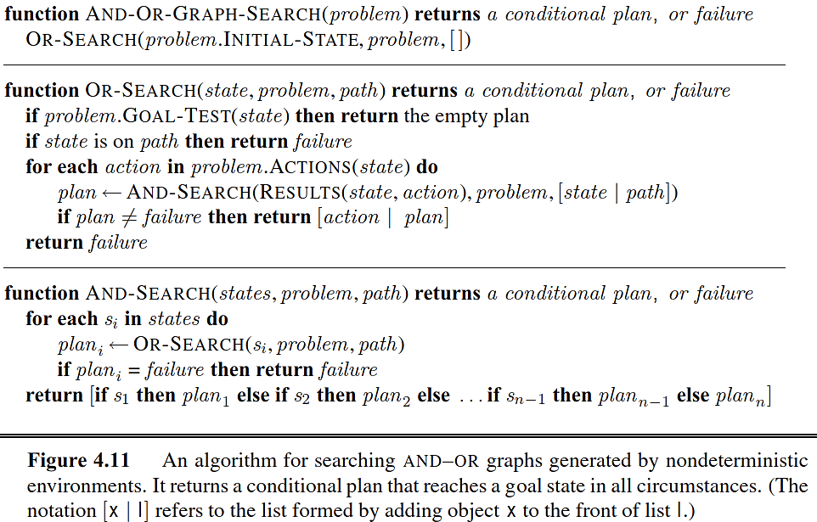























AND-OR graph search algorithm
Source: (Russell, 2016)

Slide 9




Example solution for 4-queen problem

Slide 10
SEARCHING IN NON-FULLY-OBSERVABLE ENVIROMENTS

Slide 11
Searching with no observation

Slide 12






Searching with no observation
Sensorless agents can be very useful, e.g.,
Belief state:

Slide 13
Recall: Components of a general problem
1. Initial state
2. Possible actions: ACTIONS
3. Transition model: RESULT
4. Goal test: GOAL-TEST
5. Cost: STEP-COST, PATH-COST

Slide 14
Components of the physical problem P
1. Initial state
2. Possible actions: ACTIONS_{P}
3. Transition model: RESULT_{P}
4. Goal test: GOAL-TEST_{P}
5. Cost: STEP-COST_{P} , PATH-COST_{P}

Slide 15






















Components of a sensorless problem
1. Initial state
2. Possible actions: ACTIONS(belief state b). For example, b = {s₁, s₂}, and

Slide 16







Components of a sensorless problem
3. Transition model: RESULT(belief state b, action a) = new belief state b’
4. Goal test:
5. Cost:

Slide 17
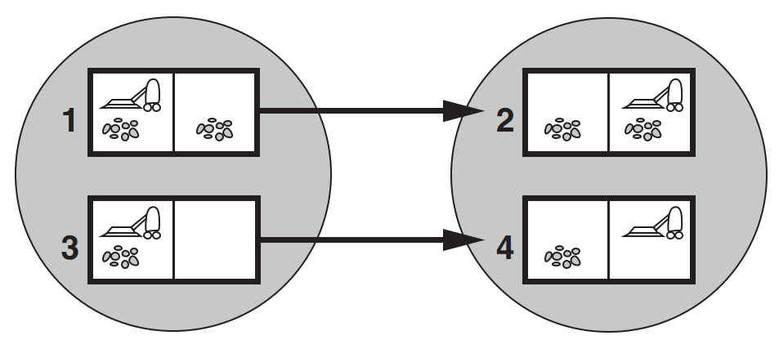

Examples of belief state and transition model
Source: (Russell, 2016)

Slide 18
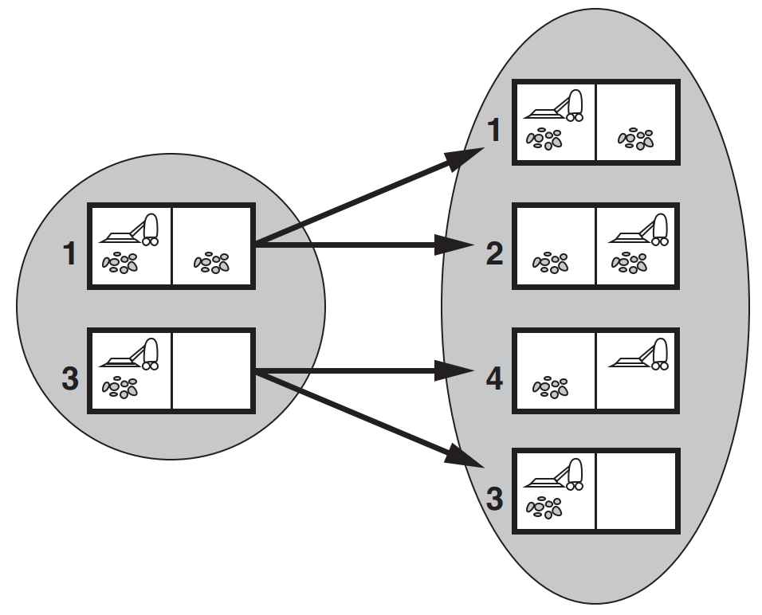

Examples of belief state and transition model
Source: (Russell, 2016)

Slide 19
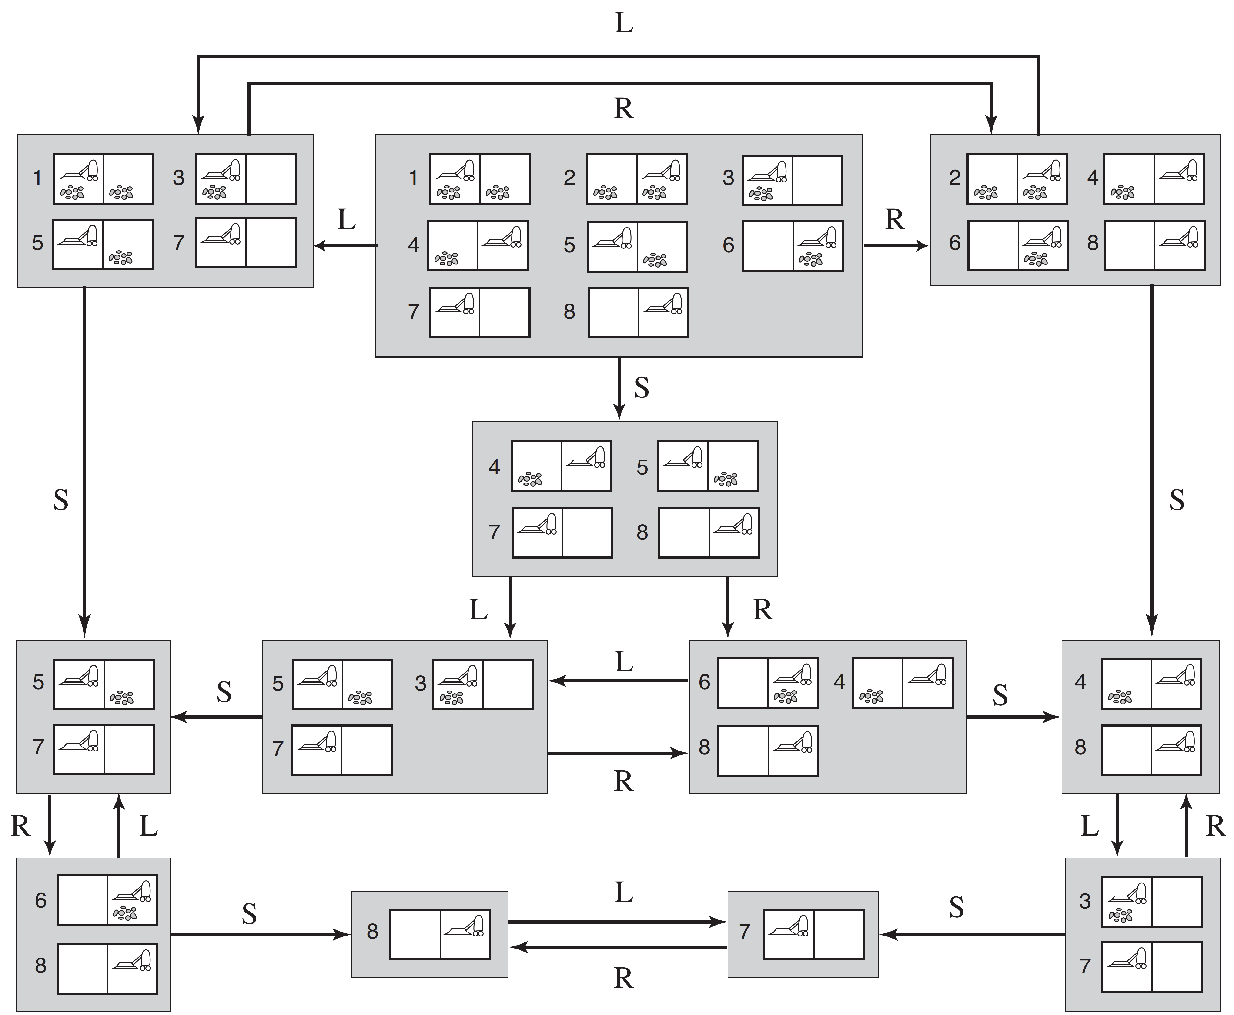







Reachable belief states of the vacuum world.
Image: (Russell, 2016)

Slide 20



With these components defined, you now can

Slide 21



However…
If the physical problem has N states, then you have ______
belief states. For example, with 100 physical states,
➔
➔ Incremental belief-state search

Slide 22








Incremental belief-state search
Solve 1 physical state at a time.
For example,
Main advantage: quickly detect failure.

